Slide 1
Toby Gard
Game Designers series
Kirill Penchukov

Slide 2
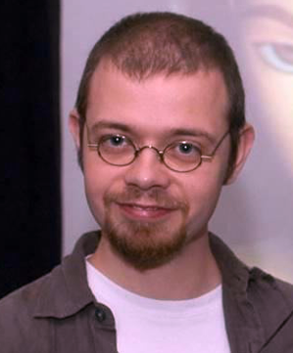

Overview
Toby Gard
Born September 8, 1972
Place of birth: Chelmsford, Essex, England
Game character designer, Animator, Writer
Created Lara Croft, female British archaeologist
Worked on Tomb Raider series and other projects
Now:
Game Consultant in Focal Point Games LLC
Co-creative Director in Tangentlemen

Slide 3

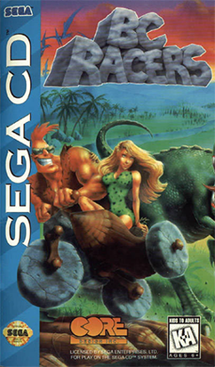
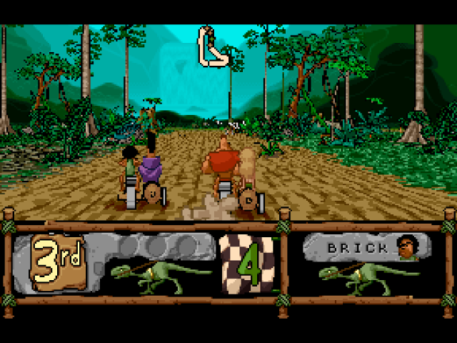
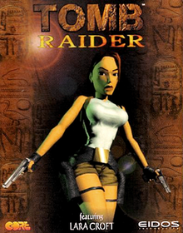
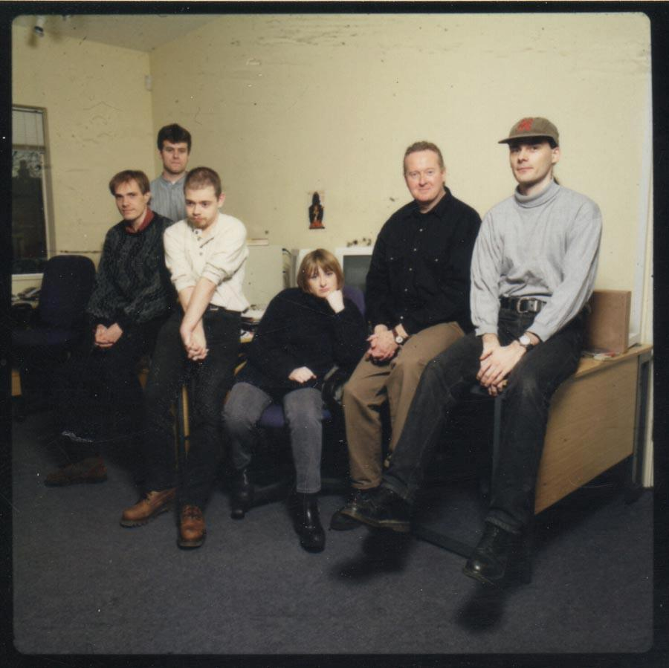
Key events
1994: BC Racers development
Toby Gard: “I don’t want to talk about it”
1995: Tomb Raider in Core Design (6-people team)
Designing Lara Croft
Developing and animating characters
Animating cut scenes and storyboarding FMVs
Managing the level designers
1997: leaving Core Design
Tomb Raider is a hit
Publisher disagreement with the heroine vision
Lack of creative freedom
Forming Confounding Factor with Paul Douglas
Announcing Galleon

Slide 4
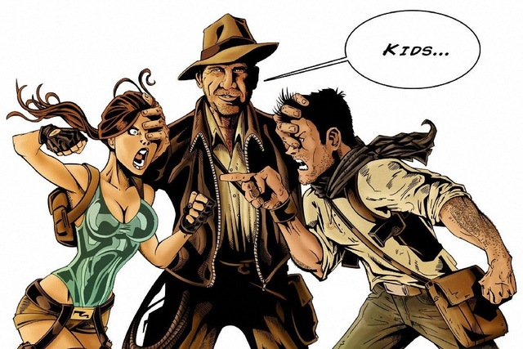
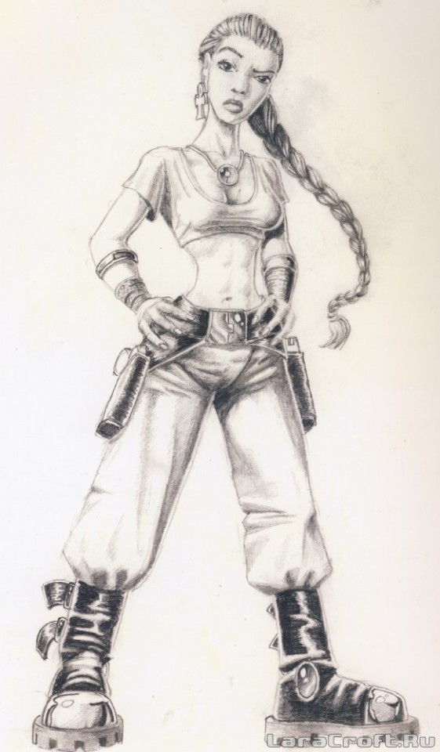
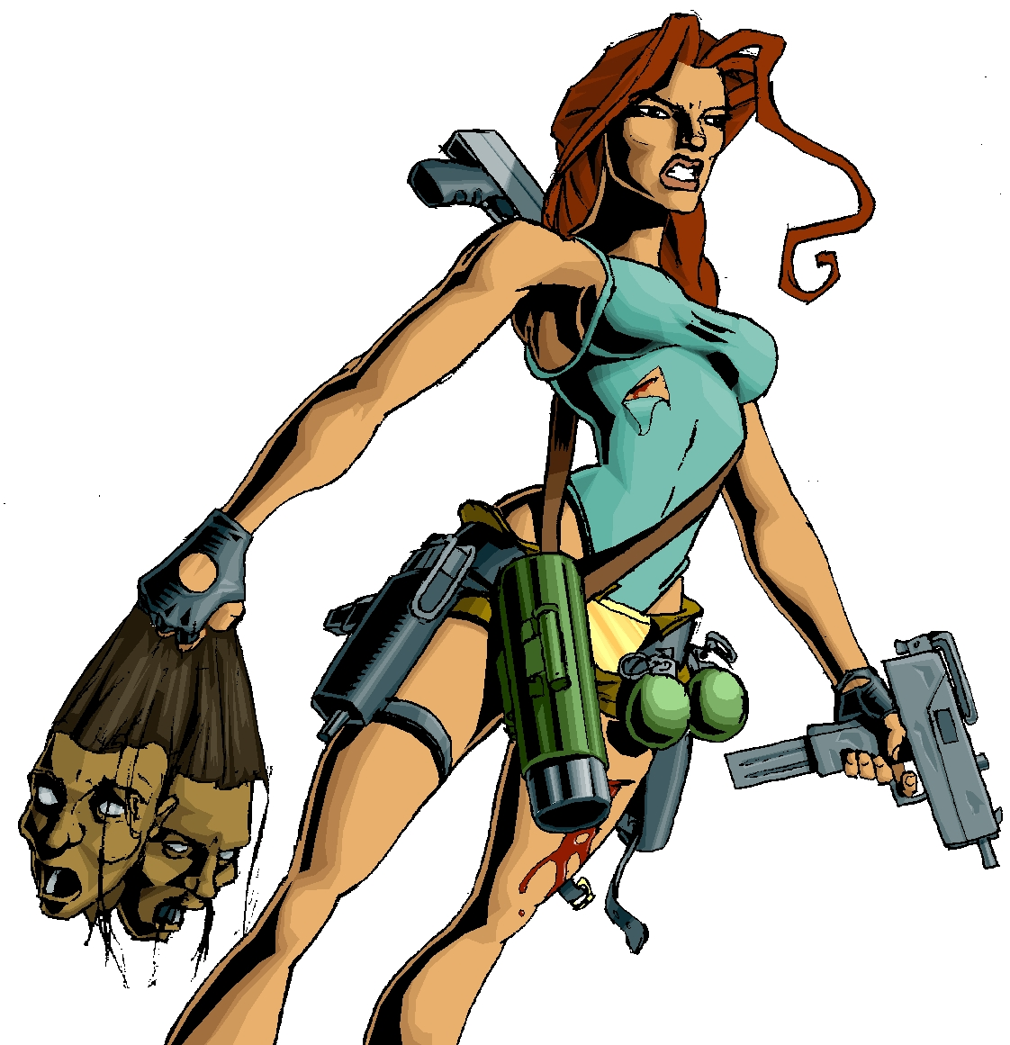
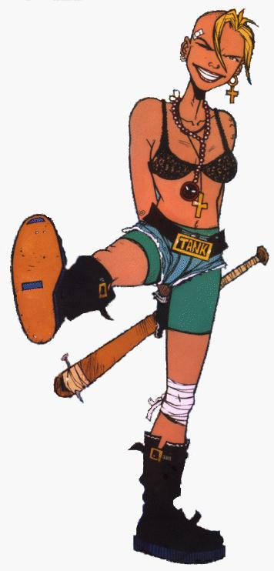


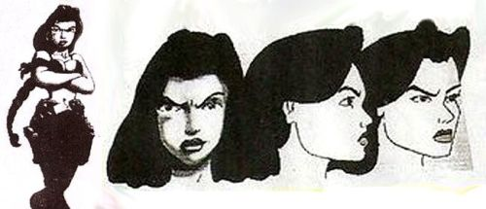
Lara Croft. Origins
Initially envisioned as a man (Indiana Jones)
Influences:
Ultima Underworld, Virtua Fighter, Prince of Persia (games)
Hard Boiled, Aeon Flux (movies)
Neneh Cherry (female singer)
Tank Girl (comic character)
Laura Cruz (South American) -> Lara Croft (British)

Slide 5
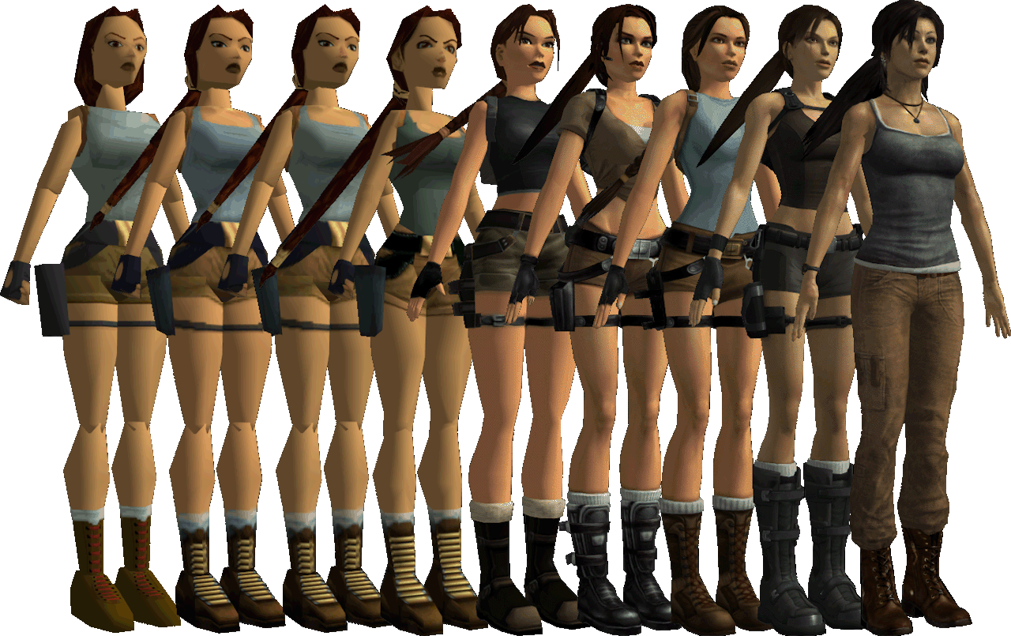
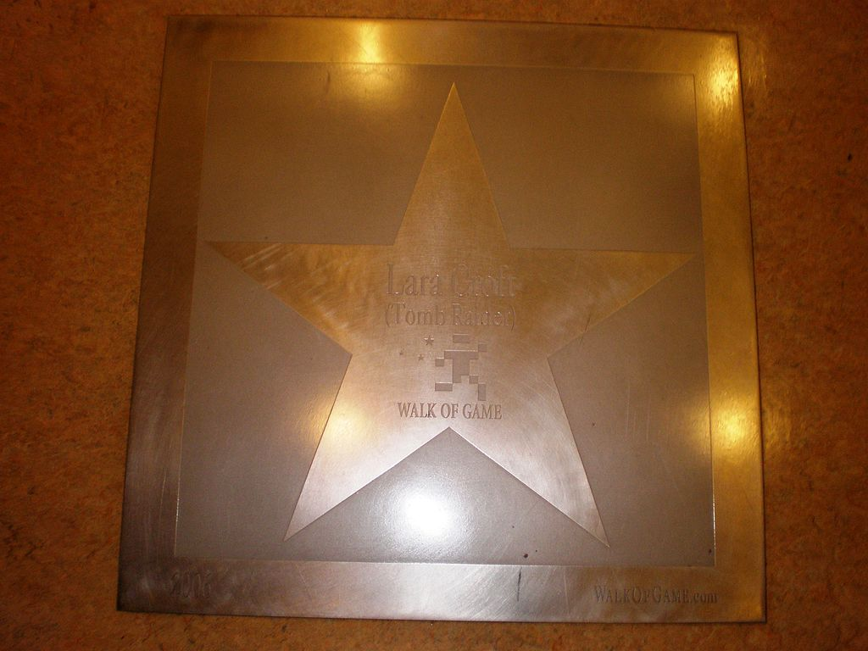
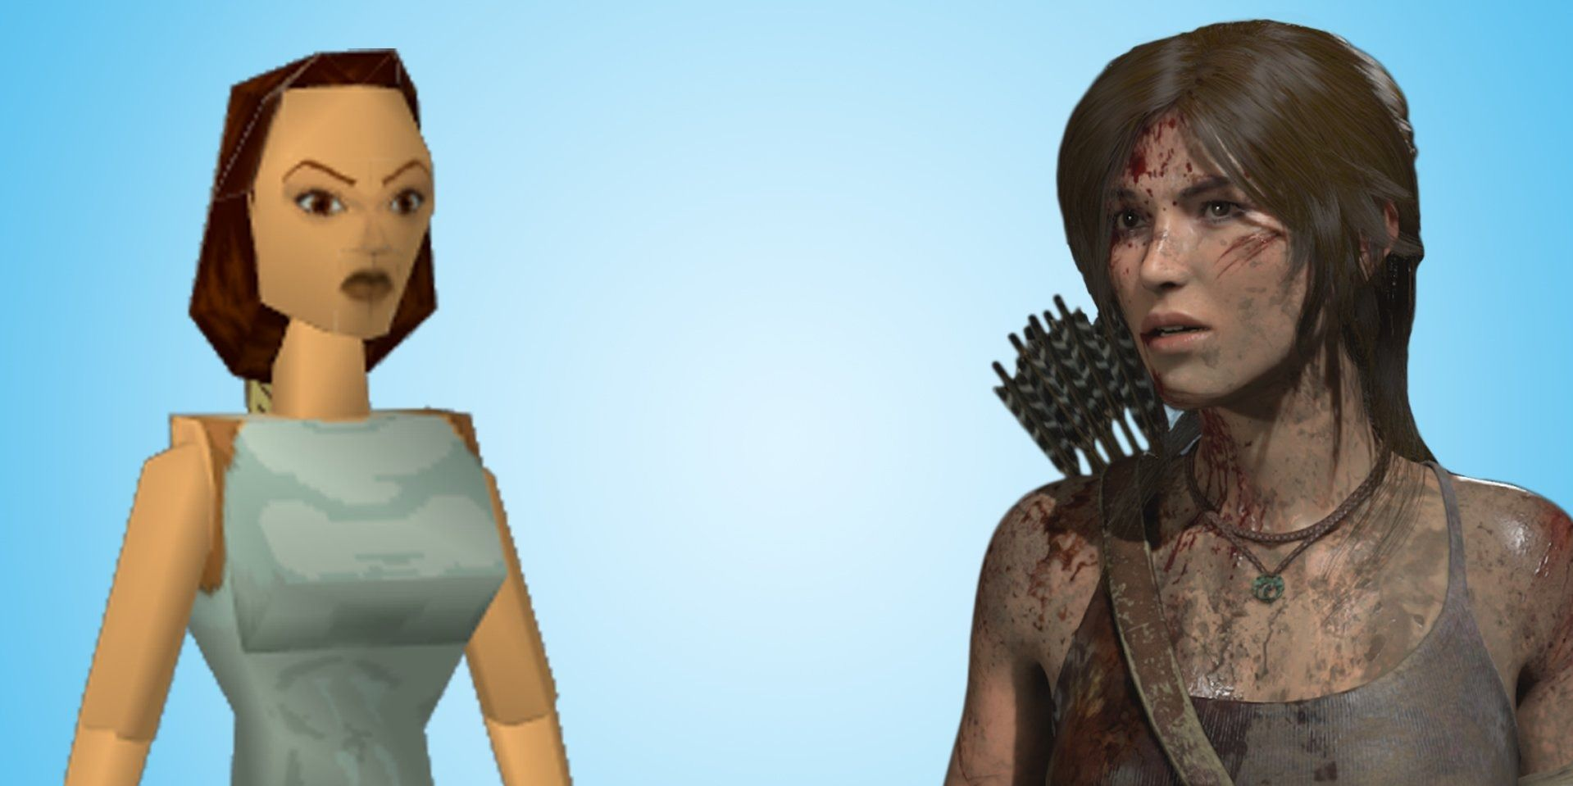
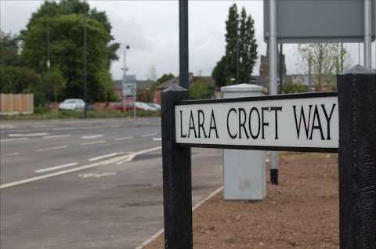
Lara Croft. Evolution
“It was never the intention to create some kind of ‘page 3’ girl to star in Tomb Raider.
The idea was to create a female character who was a heroine, you know, cool, collected…”
First model: only 230 polygons (now more than 30 thousand!)
Turning to sex symbol after the release of TR (1996)
“The best-selling video game heroine” (Guinness World Records):
March 21, 2019
44,500,000 units sold
…and many other awards!

Slide 6
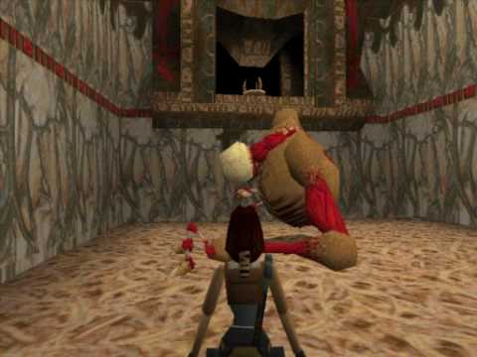
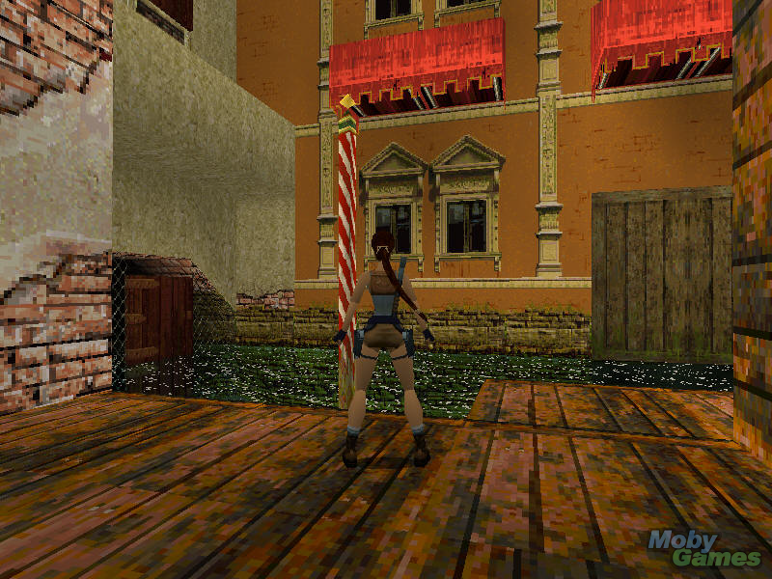
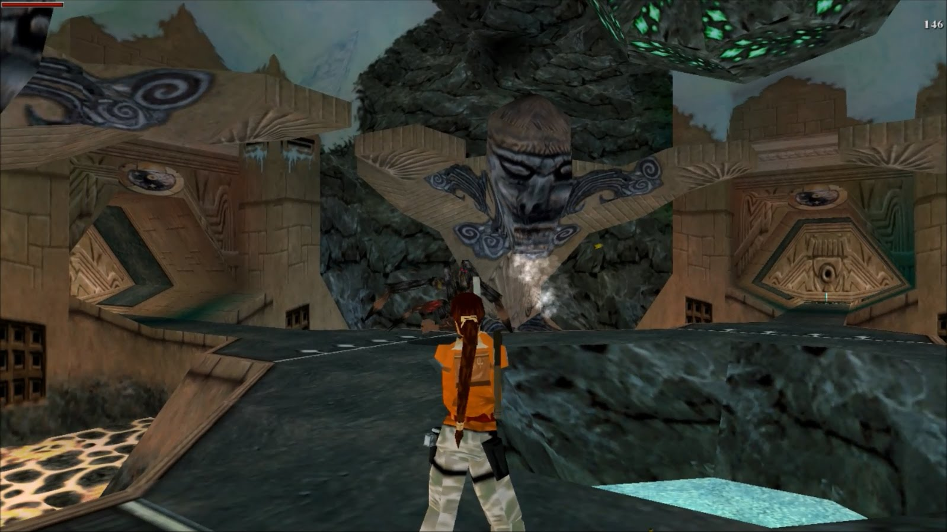
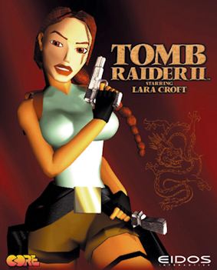
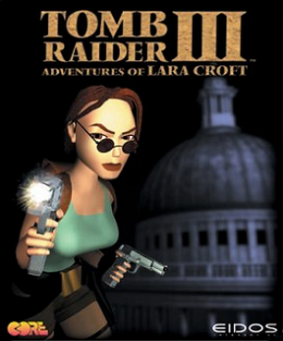
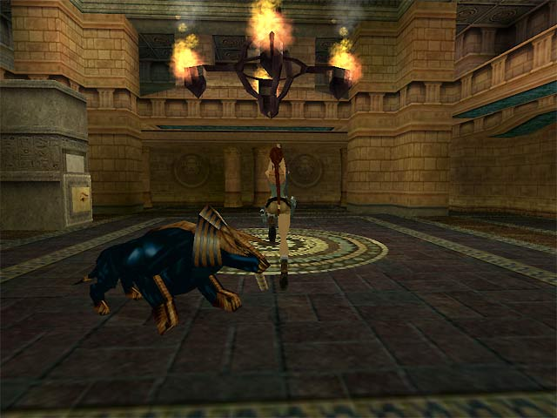
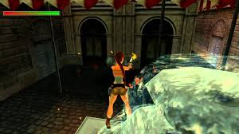
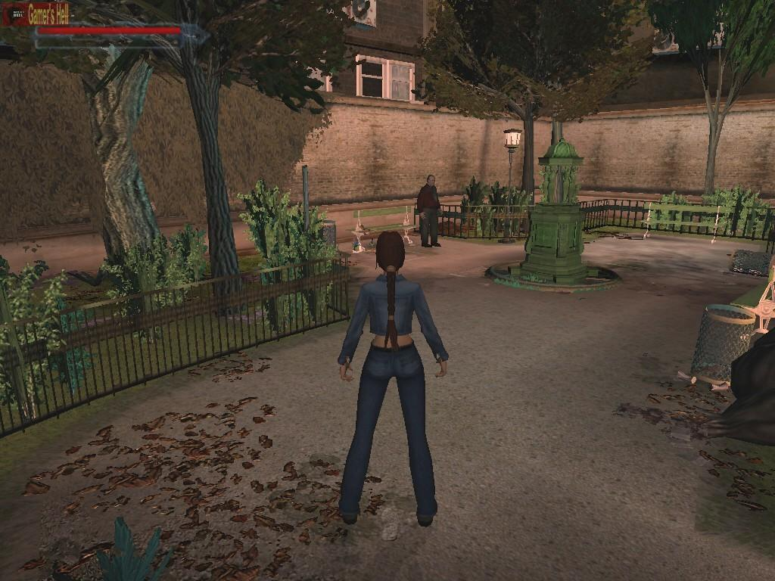
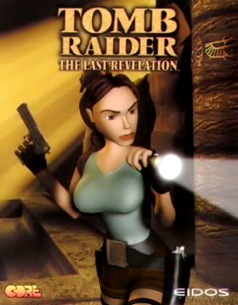
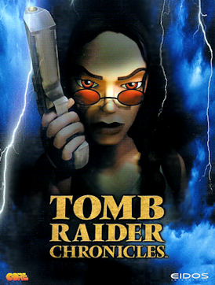
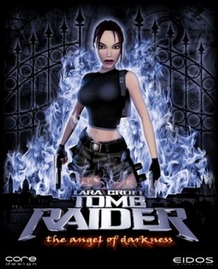
Tomb Raider (1996 – 2003)
“After all, who is more famous: Bob Kane or Batman?”
“… being better than most of the other games around at the time”
“Tomb Raider turned out pretty damn well because
we specced it fairly low. Gameplay elements in Tomb Raider
were deliberately kept simple”

Slide 7
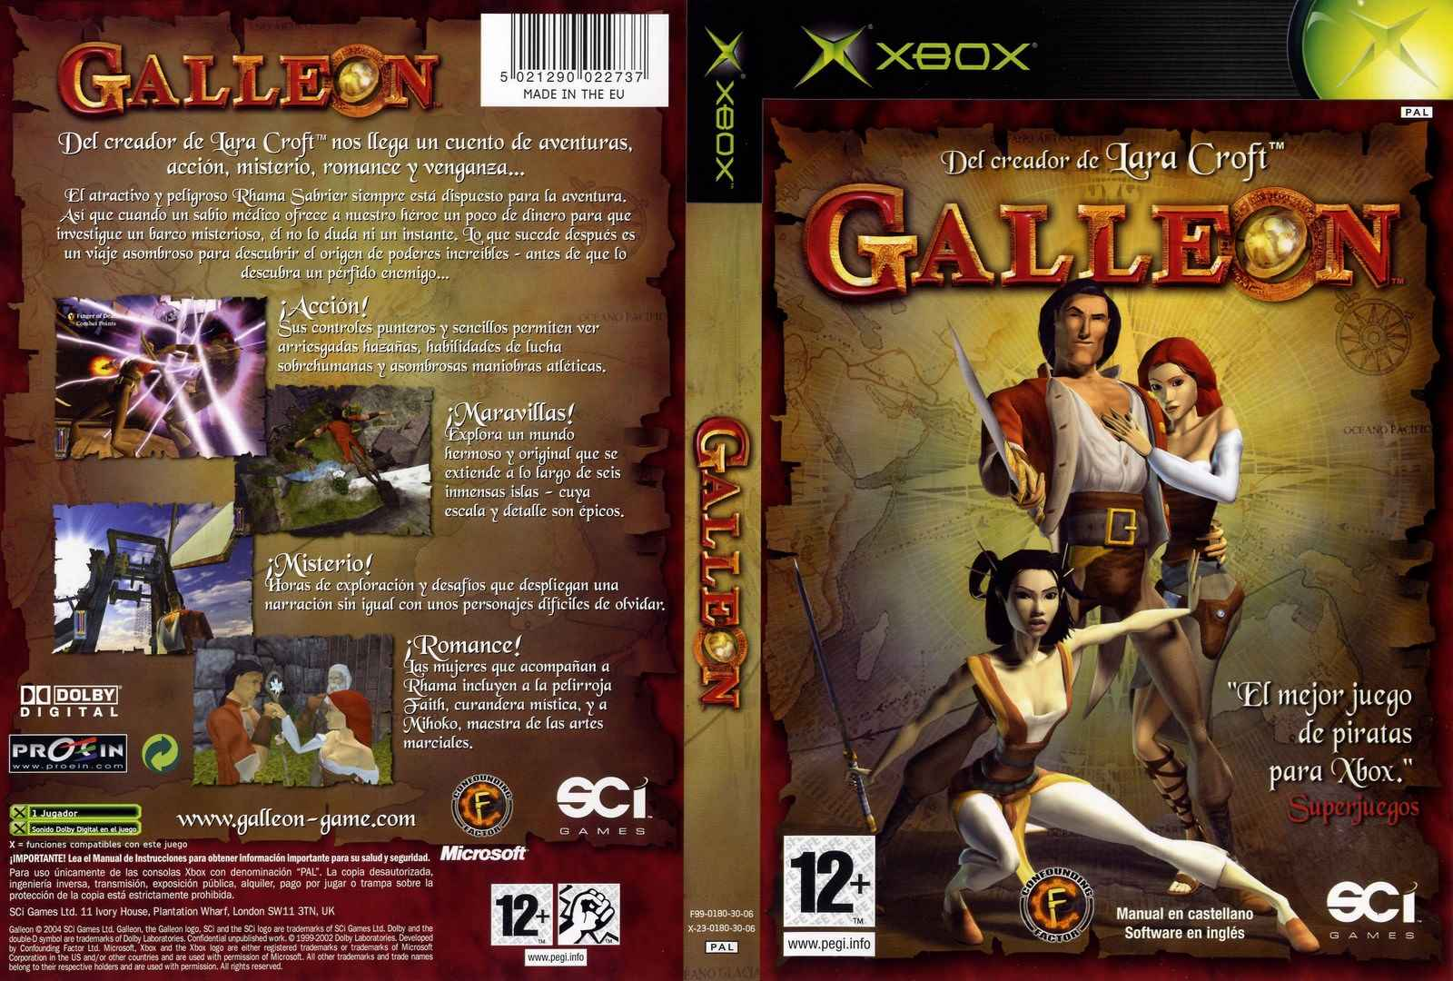
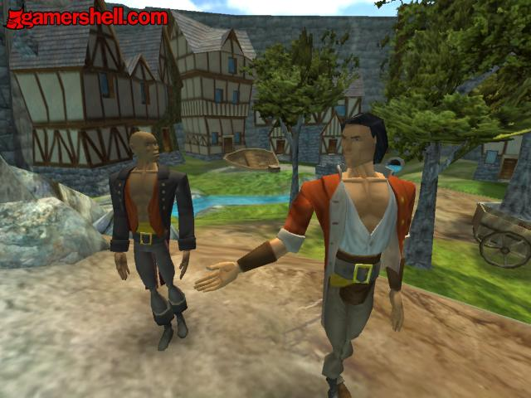
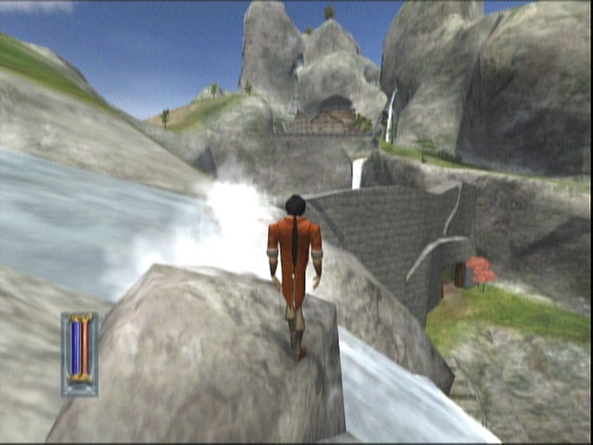
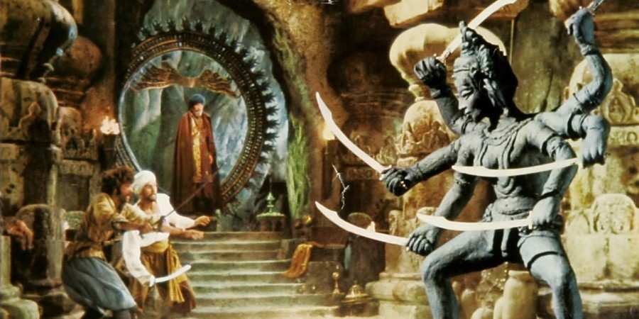
Key events
“Paul and I left Core Design because we wanted to do something new”
2004: Galleon release (10-people team) and Confounding Factor closure
“It is simply what Tomb Raider should have been”
Visual style: Comics
Influence: Sinbad movies
7 years of development
Platforms: Xbox, mobile phones
Received «average» reviews:
Metacritic: 67/100
GameRankings: 67%

Slide 8

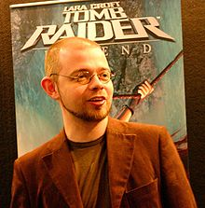

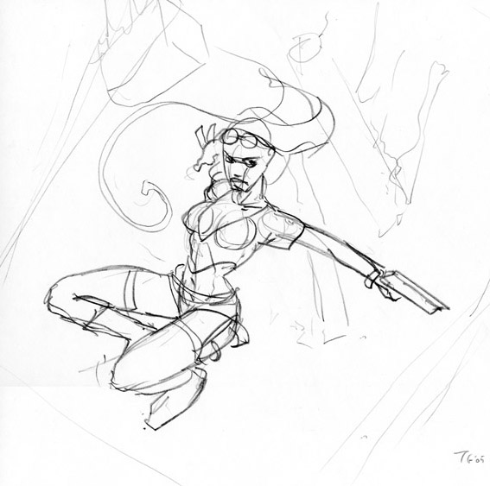
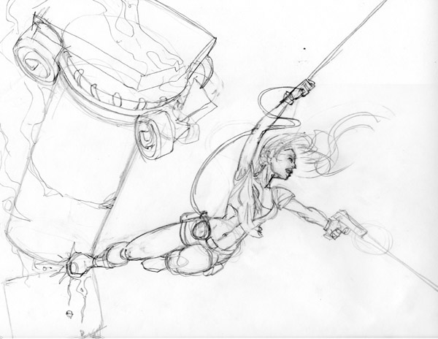
Key events
2004-2008: working in Eidos
Rebooting Tomb Raider with Crystal Dynamics
Developing trilogy: Legend, Anniversary and Underworld:
Character design
Co-writing the story
Character movement system design and implementation
Cinematics, voice and motion capture direction
Nomination for «Best Writing in a Video Game» by the Writers Guild of America

Slide 9
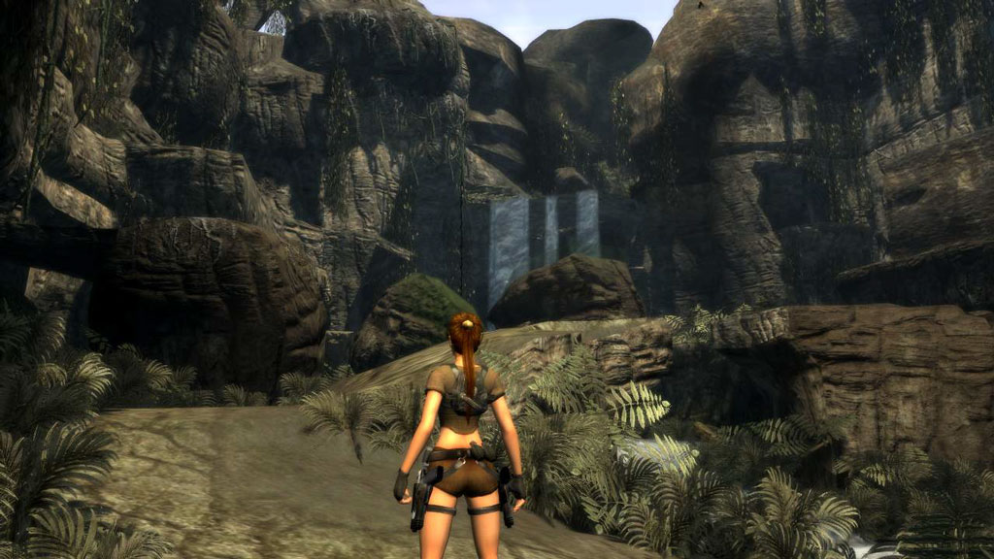
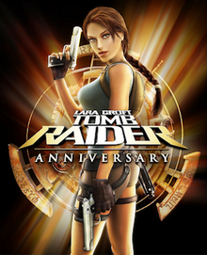
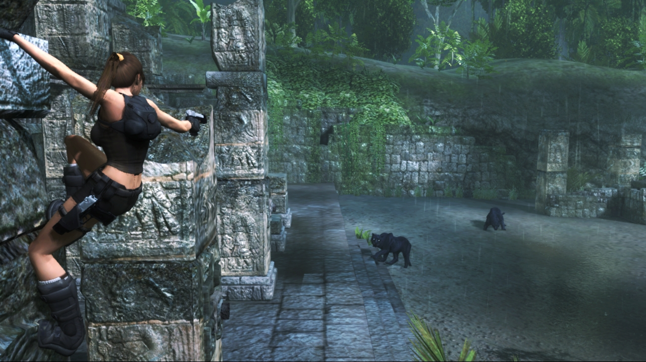
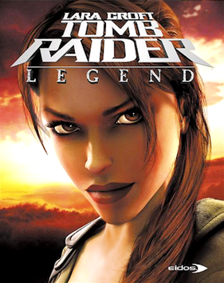
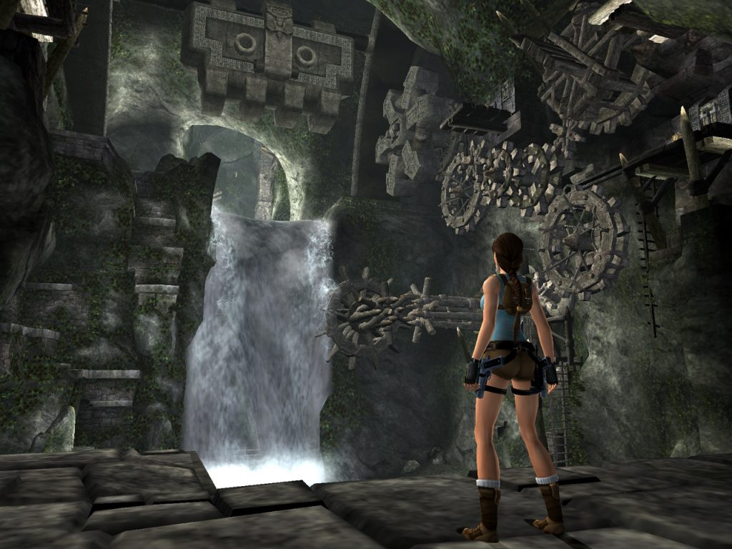
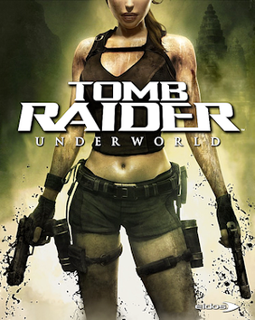
Tomb Raider (2006 – 2008)
“People are only interested in playing sequels if they haven’t had enough of the first one or if they haven’t played the first one and hope that the sequel will be better”
Series ‘resurrection’
Main character and game world redesign
Core changes in gameplay: from puzzles to action
Using Motion Capture technology in TR: Underworld

Slide 10




Key events
“Putting together the right team is the most difficult thing we had to do”
2009: Game Consultant in Focal Point Games LLC
2010-2012: Webcomic Otherworld (individually)
2012-2014: Game Director of Yaiba: Ninja Gaiden Z in Spark Unlimited
2014: establishing Tangentlemen
Former Spark Unlimited team
“Experiential Game Design”
Here They Lie (2016) is the company’s only project
Current status is unknown

Slide 11
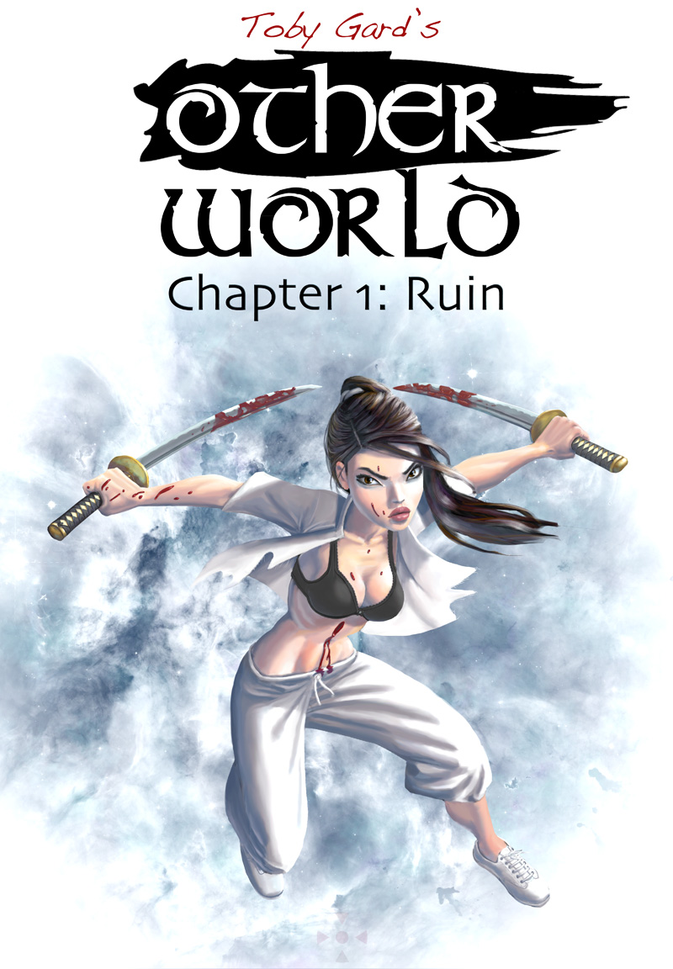
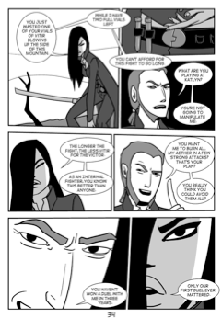

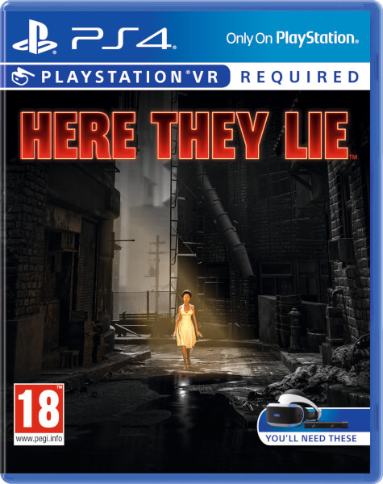
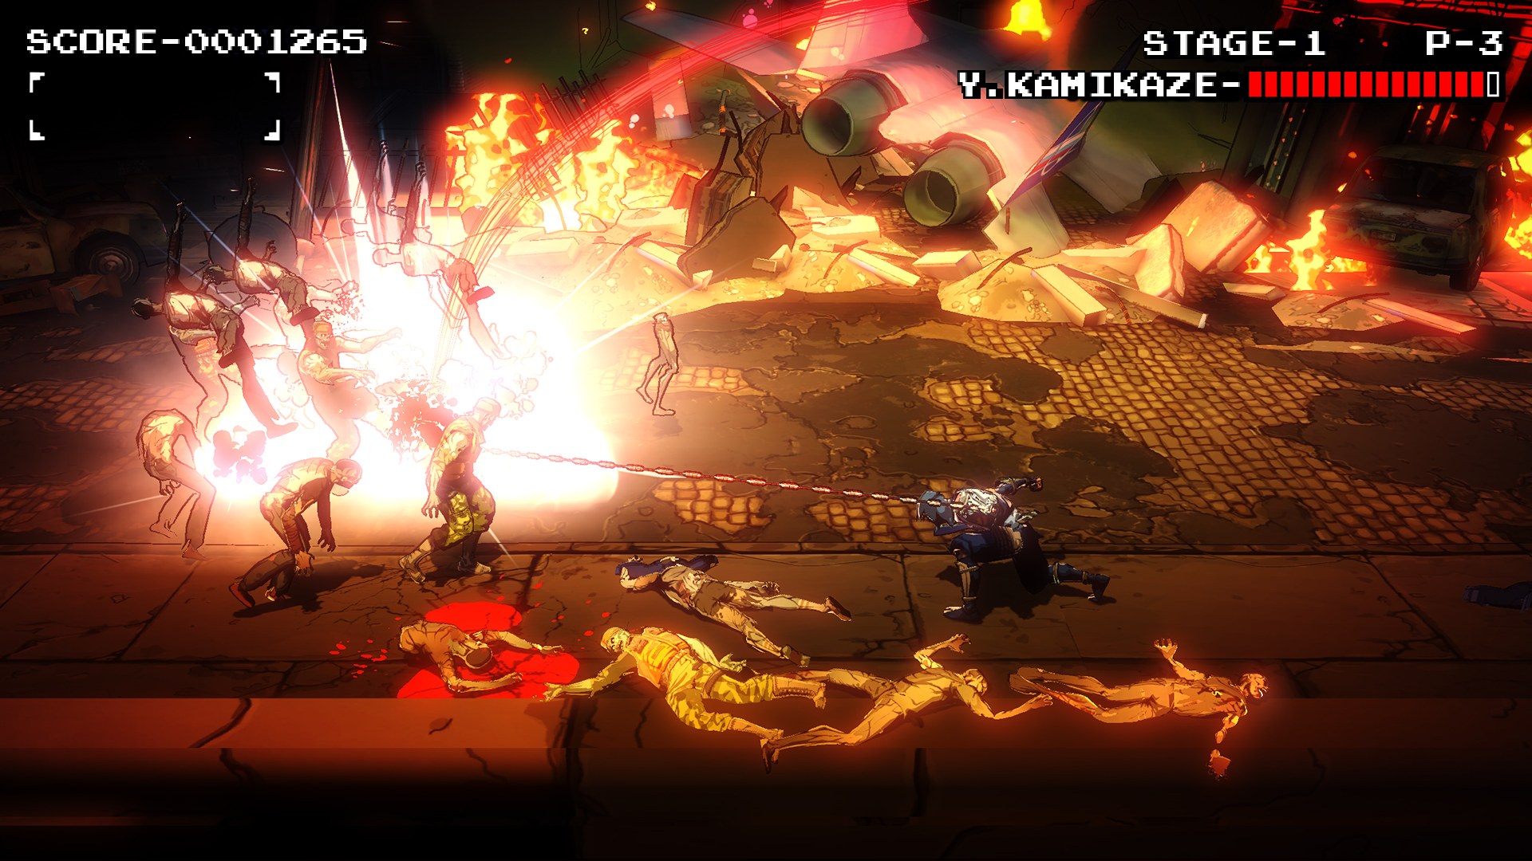
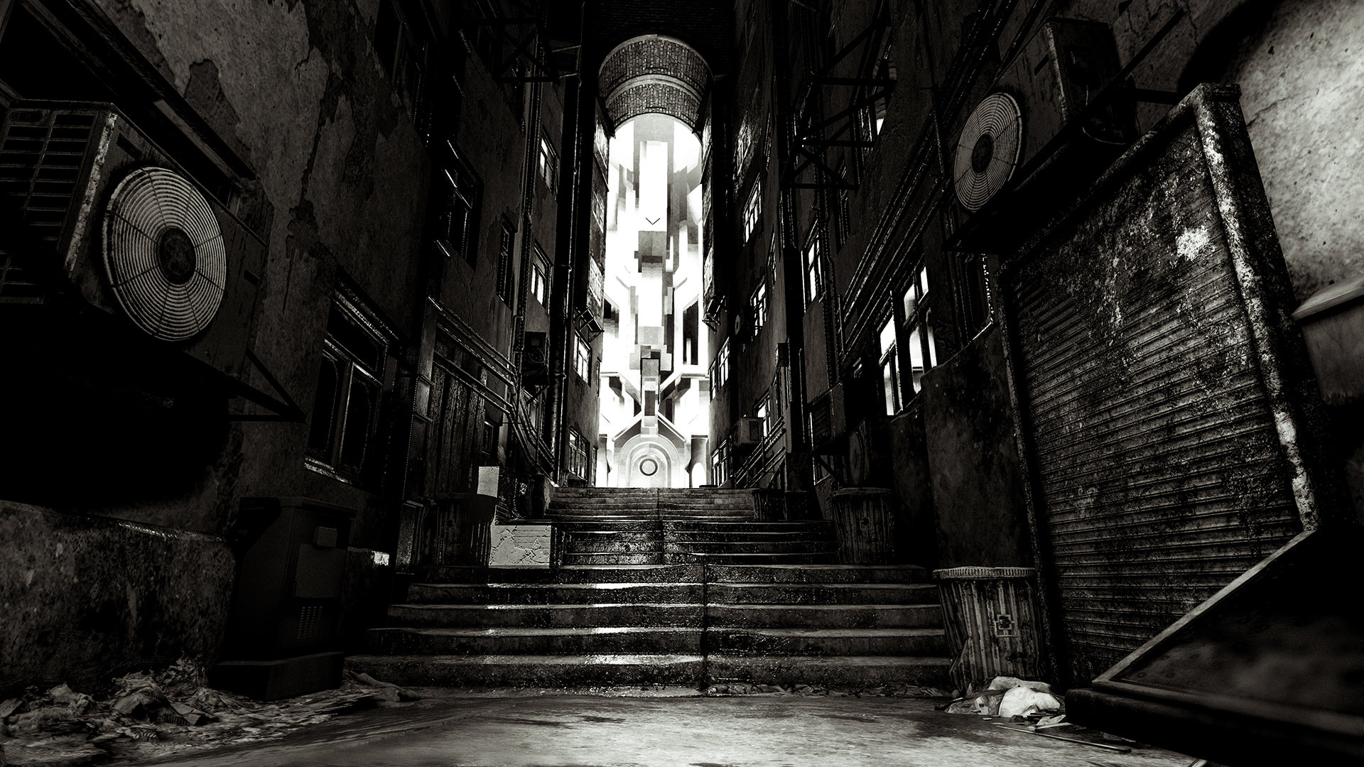
Otherworld
The comic book about an ancient conspiracy…
…as well as the existence of other worlds
3 large parts
Updated once a week
“I want you to read this story as soon as possible”
Unpublished book (2009) -> unrecognized game concepts (2010) -> webcomic
Yaiba: Ninja Gaiden Z
“Live comic book”
Hack’n’Slash with ninjas and zombies
Ninja Gaiden universe
Mixed and negative reviews:
Metacritic: 43/100
GameRankings: 44.18%
GamesRadar: “100 worst games of all time”
Here They Lie
Psychological Horror in VR
“Focuses on narrative and the experience of dread”
Trial-and-error – minimum hints
The release was timed to match the launch of PlayStation VR
Mixed reviews but not a failure

Slide 12

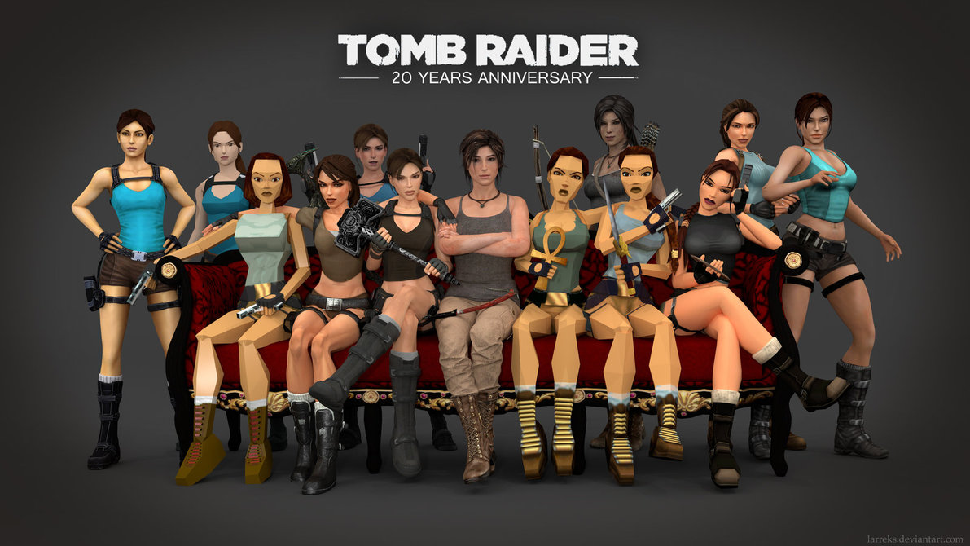
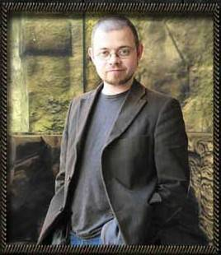
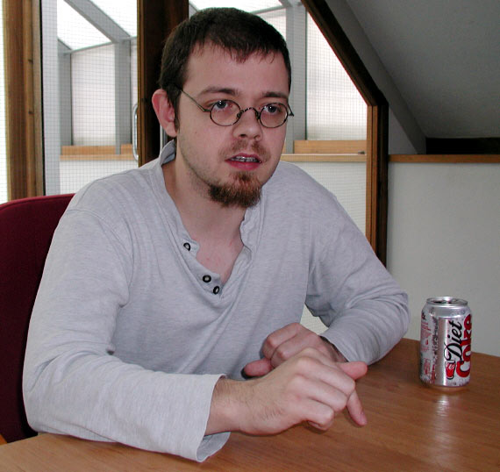
Thank you!
Any questions?

